Slide 1

Advanced Programming CMP 102
Dr. Perihan PEHLİVANOĞLU
Biruni Univarsity
Department of Computer Engineering 2023
Spring

Slide 2
Course Plan
Introduction - Functions (Recursive functions) Arrays, ArrayList, Vector
Collections (List, Queue, Stack, Set, Map, Tree)
Streams, Files
Generics and Exceptions
Midterm Exam

Slide 3
Course Plan
Visual Programming Fundamentals Designing a Form Controls and Forms Properties of Components and Events Final Exam

Slide 4

Last Lecture
We learned records. We have learned exceptions.

Slide 5
Introduction
In this lecture, we will learn further in exceptions then files.

Slide 6
EXCEPTION MANAGEMENT

Slide 7
Exceptions
Exceptions are used to manage run-time errors. The try-catch block is used.

Slide 8
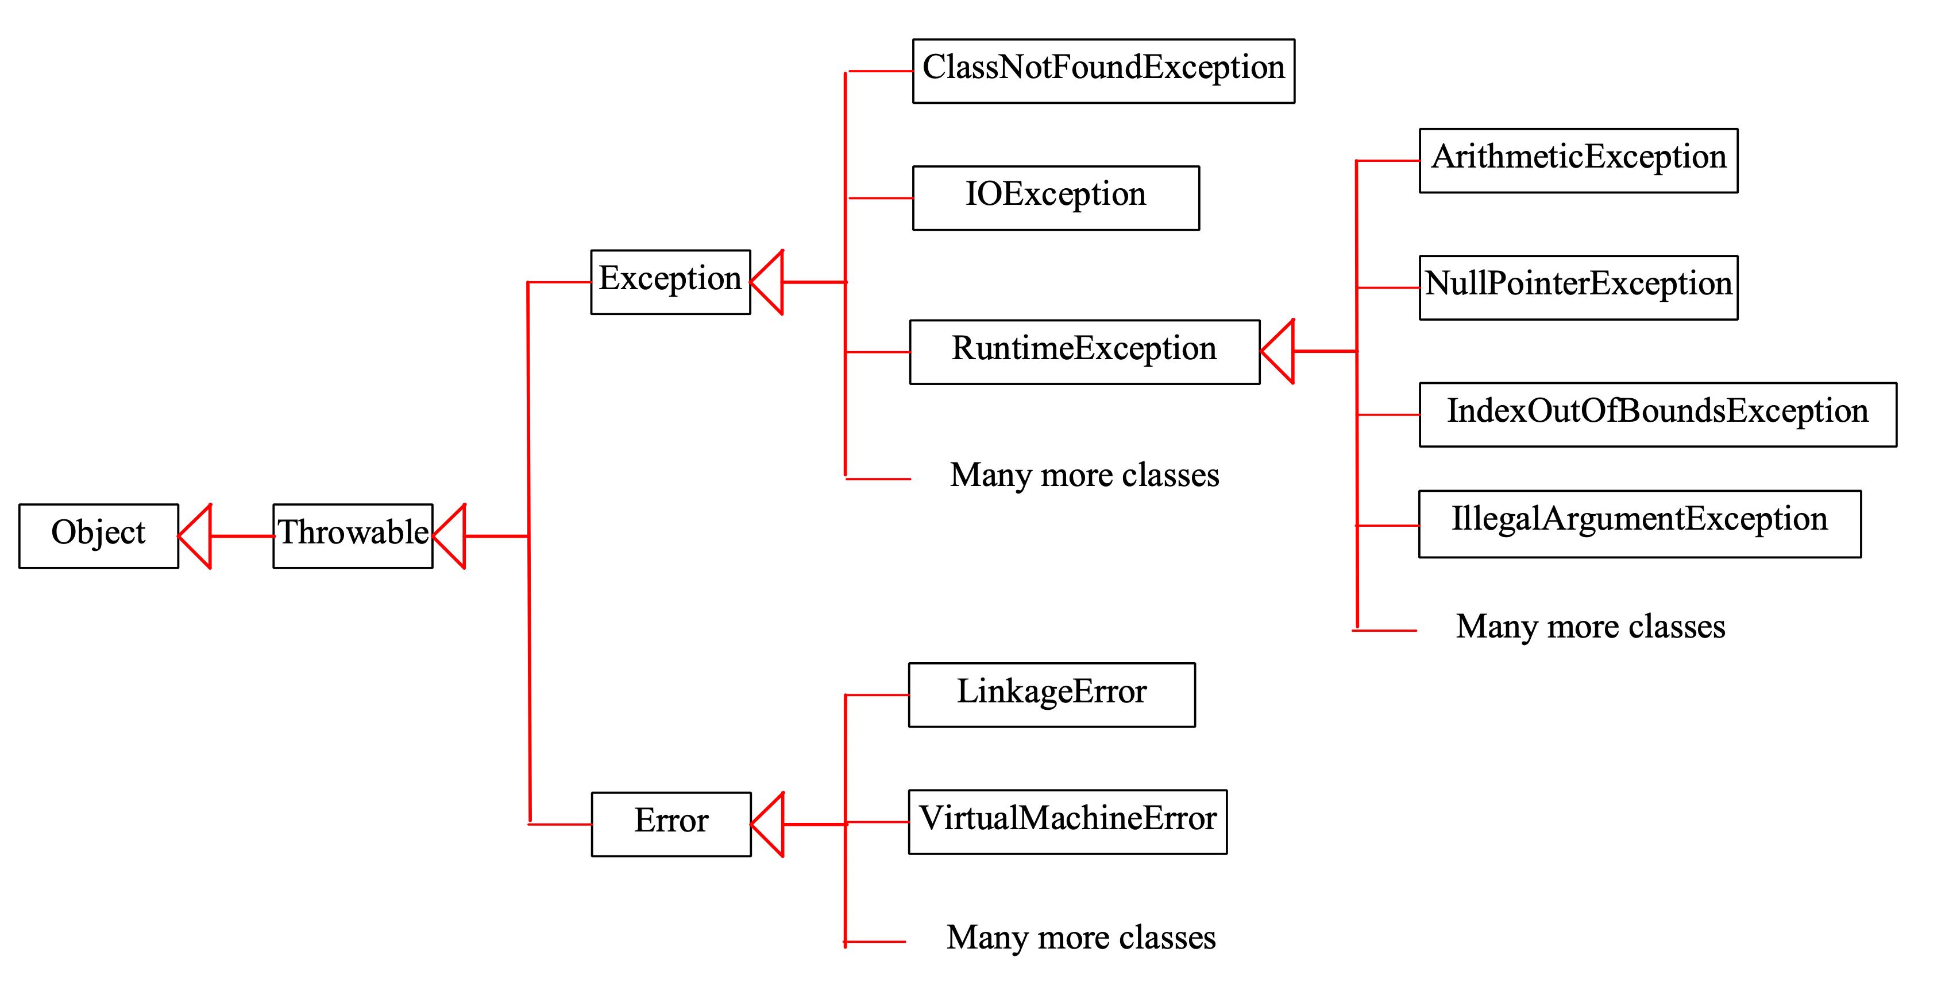
Exceptions

Slide 9
Exceptions
System errors are generated by the JVM and the Error class. These types of mistakes rarely happen, and as a Programmer you can't do much about them. You simply tell the user that he needs to terminate the program and give the error message.

Slide 10
Exceptions
An exception is caused by errors that originate in your program and outside the program. You can catch such exceptions and resolve them by your program.

Slide 11
Exceptions
The RuntimeException is caused by programming errors. Such as out-of-bounds in an array.

Slide 12
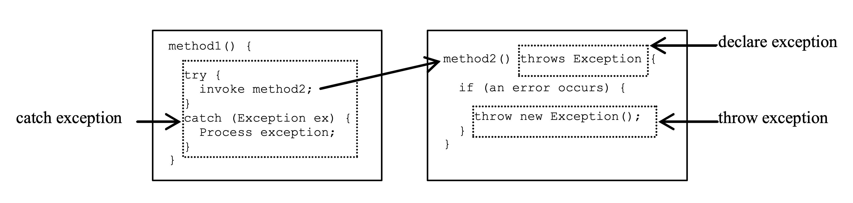
Exceptions
Exception definition and catch it.

Slide 13
Exceptions
When defining an exception, the exceptions that each method can throw are defined.
public void myMethod()
throws IOException
public void myMethod()
throws IOException, OtherException

Slide 14
Exceptions
When the program notices an error, the appropriate exception is generated and sent. This is known as throwing an exception.
throw new TheException();
TheException ex = new TheException(); throw ex

Slide 15
Exceptions
Catch the exception try {
statements; // Statements that may throw exceptions
}
catch (Exception1 exVar1) {
handler for exception1;
}
catch (Exception2 exVar2) {
handler for exception2;
}
...
catch (ExceptionN exVar3) {
handler for exceptionN;
}

Slide 16
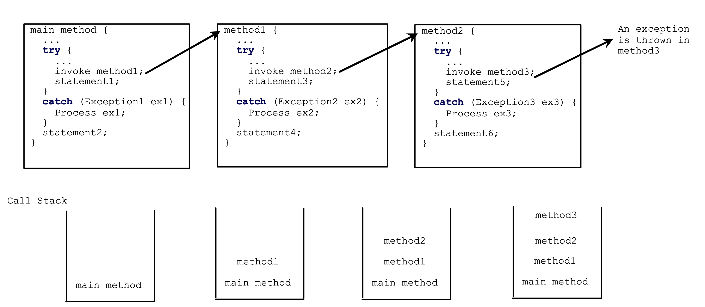
Exceptions

Slide 17
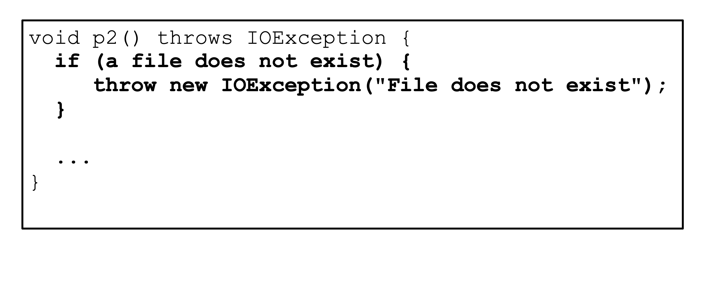
Exceptions

Slide 18
Exceptions
Finally statement
try {
statements;
}
catch(TheException ex) {
handling ex;
}
finally {
finalStatements;
}

Slide 19
Exceptions
Suppose there is no exception here.
try {
statements;
}
catch(TheException ex) {
handling ex;
}
finally {
finalStatements;
}
Next statement;

Slide 20
Exceptions
try {
statements;
}
catch(TheException ex) {
handling ex;
}
finally {
finalStatements;
}
Next statement;
This block is always executed.

Slide 21
Exceptions
try {
statements;
}
catch(TheException ex) {
handling ex;
}
finally {
finalStatements;
}
Next statement;
The next statement is executed.

Slide 22
Exceptions
try {
statement1;
statement2;
statement3;
}
catch(Exception1 ex) {
handling ex;
}
finally {
finalStatements;
}
Next statement;
Suppose an exception occurs of type Exception1 and is caused by statement2.

Slide 23
Exceptions
try {
statement1;
statement2;
statement3;
}
catch(Exception1 ex) {
handling ex;
}
finally {
finalStatements;
}
Next statement;
The exception is resolved.

Slide 24
Exceptions
try {
statement1;
statement2;
statement3;
}
catch(Exception1 ex) {
handling ex;
}
finally {
finalStatements;
}
Next statement;
The final block is always executed.

Slide 25
Exceptions
try {
statement1;
statement2;
statement3;
}
catch(Exception1 ex) {
handling ex;
}
finally {
finalStatements;
}
Next statement;
The next statement is executed.

Slide 26
Exceptions
try {
statement1;
statement2;
statement3;
}
catch(Exception1 ex) {
handling ex;
}
catch(Exception2 ex) {
handling ex;
throw ex;
}
finally {
finalStatements;
}
Next statement;
statement2 throw exception of type Exception2.

Slide 27
Exceptions
try {
statement1;
statement2;
statement3;
}
catch(Exception1 ex) {
handling ex;
}
catch(Exception2 ex) {
handling ex;
throw ex;
}
finally {
finalStatements;
}
Next statement;
Resolve an exception

Slide 28
Exceptions
The final block is executed.
try {
statement1;
statement2;
statement3;
}
catch(Exception1 ex) {
handling ex;
}
catch(Exception2 ex) {
handling ex;
throw ex;
}
finally {
finalStatements;
}
Next statement;

Slide 29
Exceptions
try {
statement1;
statement2;
statement3;
}
catch(Exception1 ex) {
handling ex;
}
catch(Exception2 ex) {
handling ex;
throw ex;
}
finally {
finalStatements;
}
Next statement;
The rethrow exception and control return to the caller.

Slide 30
Exceptions
Let there be an exception in one method. If you want the exception to be handled by the caller, you must create an exception and throw it away. If you think you can resolve the exception where the exception occurs in the method, you don't need to throw it away.

Slide 31
Exceptions
When we make something wrong, for example; Division by 0, when we enter the data type incorrectly, we encounter messages indicating why the error is the cause. After the word try, the code to be executed, and after the catch word, there is a message to be given if this code does not work. You can also create the exception. Throw is also used for this.
With or without exception, those written after the finally are executed.

Slide 32
Exception Example
For division by zero and mistyping in data entry write a program that manages exceptions.

Slide 33
Exception Example
import java.util.*; public class Exception2 { public static void main(String[] args) { int number1, number2, number3; Scanner input = new Scanner(System.in); System.out.println("Enter two numbers for division : "); try { number1=input.nextInt(); number2= input.nextInt(); number3=number1/number2; } catch (ArithmeticException e) { System.out.println("Division by Zero Error."); } catch (InputMismatchException e) { System.out.println("Please only enter integer."); } finally { System.out.println("End of program."); } } }

Slide 34
FILES

Slide 35
Files
Programs today use files to store and read data. Some examples;
Word Processors
Database Management Systems Spreadsheets Compilers

Slide 36
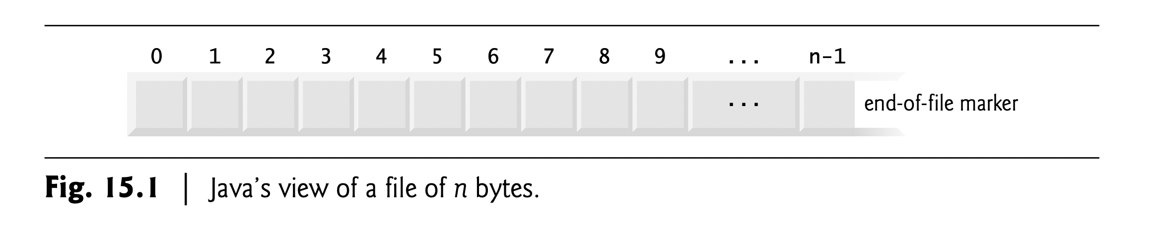
Files
Data is temporarily stored in variables and arrays. The data is deleted at the end of the program. The data is stored on the computer in the structure we call a file to be used after it is created. In our daily lives, we constantly store information in files.
The data is stored in text or binary files. In Java, files are treated as sequential streams of bytes. Operating systems have mechanisms that determine each file break with an end-of-file-marker.

Slide 37
Files
File streams accept data as bytes or characters as inputs and outputs.
Byte-based streams, input and output are in binary format. One char 2 bytes, one int 4 bytes, one double 8 bytes, etc. Character-based streams, input and output are in character format. Each character is 2 bytes. The number of bytes depends on the number of characters in a value. For example, 10 bytes for 20000 (5 characters, 2 bytes per character),
The file created with byte-based streams is called a binary file, the file created with character-based streams is called a text file. You can read the text files with the text editor, but you cannot read the binary files with the editor. These files are processed with programs.

Slide 38
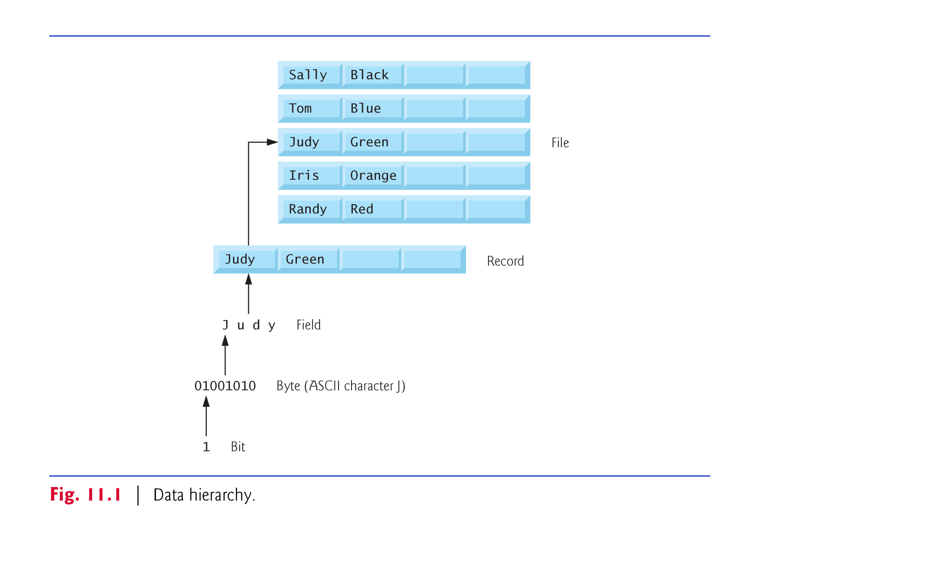
Files

Slide 39
Files
Each file ends with an end-of-file marker that indicates the end of the file. When a file is opened, a stream is associated with the file. When a program starts running, 3 types of streams are automatically opened;
standard input (System.in),
standard output (System.out) ve
standard error (System.err).
Thanks to streams, a communication (channel) is created between files and programs. In Java, the java.io.* library is used for files.

Slide 40
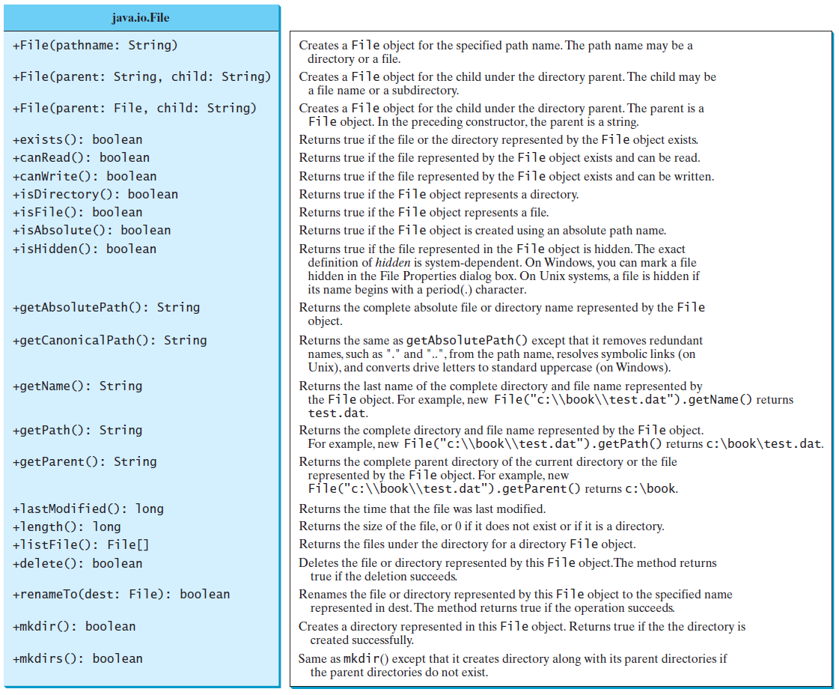
Files

Slide 41
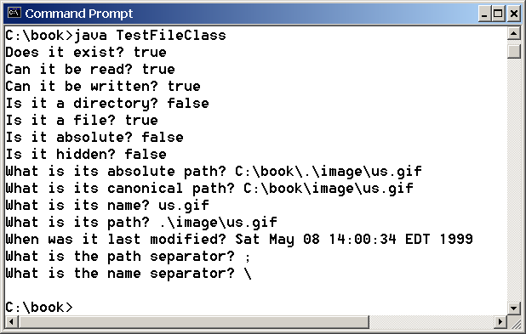
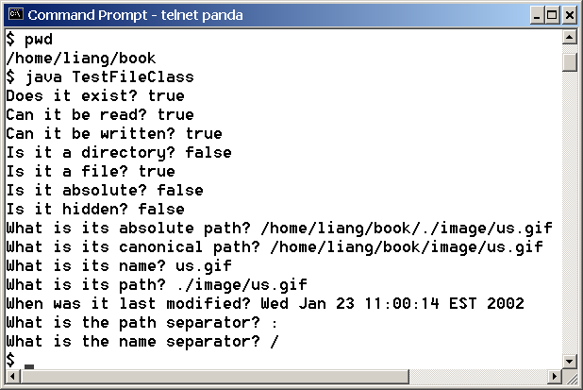
Files
The example program is related to a file and its properties.
TestFileClass
Run

Slide 42
Files
First of all, let's do sequential-access with text files. Let's deal with Scanner and PrintWriter. When processing files the operations are performed in the following order:
Open file Write to file
Close file

Slide 43
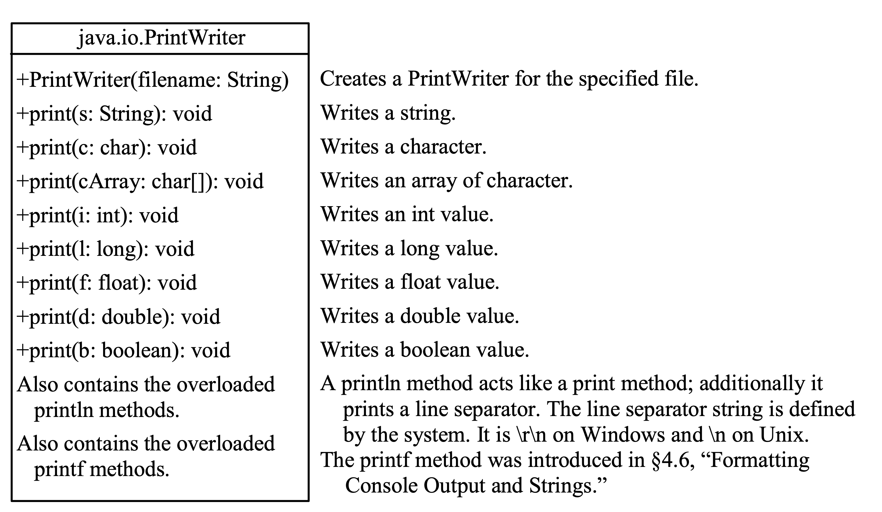
Writing to a File with PrintWriter

Slide 44
Files
import java.util.*;
import java.io.*;
public class FileProgram {
public static void main(String[] args) throws java.io.IOException {
File dosya = new File("dosyalar.txt");
PrintWriter output = new PrintWriter(dosya);
output.println("Ali");
output.println("Ayse");
output.close();
}
}

Slide 45
Writing to a File with PrintWriter
public class example1 {
public static void main(String[] args) throws java.io.IOException {
java.io.File file = new java.io.File("scores.txt");
if (file.exists()) {
System.out.println("File already exists");
System.exit(0);
}
// Create a file
java.io.PrintWriter output = new java.io.PrintWriter(file);
// Write formatted output to the file
output.print("John T Smith ");
output.println(90);
output.print("Eric K Jones ");
output.println(85);
// Close the file
output.close();
}
}
WriteData
Run

Slide 46
Let’s remember iterators in ArrayList.

Slide 47
Iterators
The Iterator is used to access the elements stored in the collection. Works like a pointer.
for (Teacher teacherA: tchList)
System.out.println(teacherA);
Iterator itr= tchList.iterator();
while(itr.hasNext())
System.out.println(itr.next());

Slide 48
Let’s read contents of file with Scanner.

Slide 49
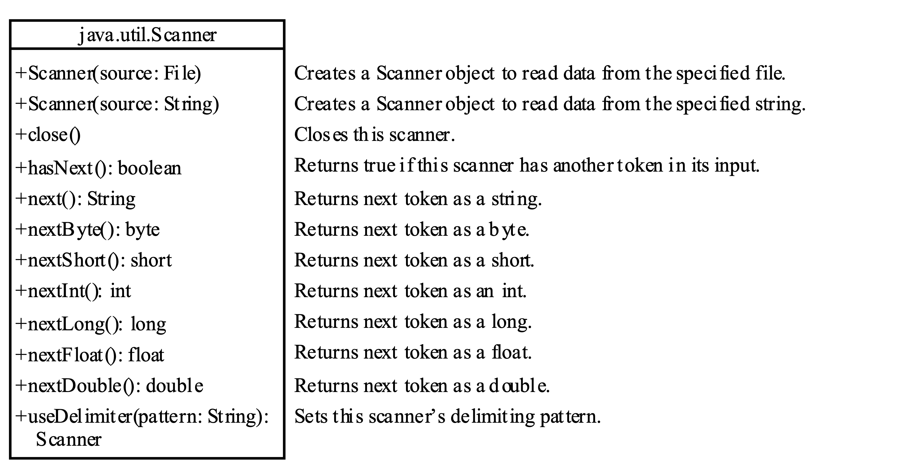
Reading a File with Scanner

Slide 50
Reading from a File with Scanner
import java.util.Scanner;
import java.io.File;
public class example1 {
public static void main(String[] args) throws Exception {
// Create a File instance
File file = new File("scores.txt");
// Create a Scanner for the file
Scanner input = new Scanner(file);
// Read data from a file
while (input.hasNext()) {
String firstName = input.next();
String mi = input.next();
String lastName = input.next();
int score = input.nextInt();
System.out.println(
firstName + " " + mi + " " + lastName + " " + score);
}
// Close the file
input.close();
}
}
ReadData
Run

Slide 51
Replacing Text in a File with Another Text
Replacement program
ReplaceText
Run

Slide 52
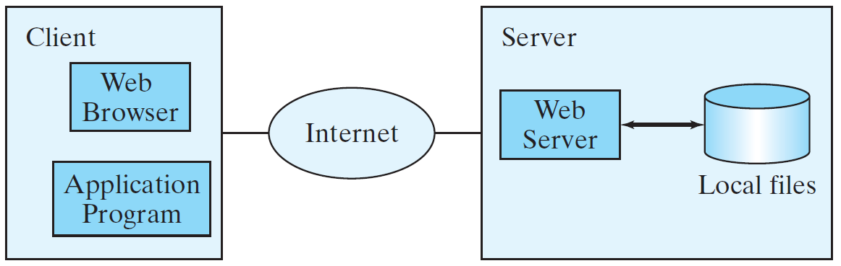
Read Data from the Web
You can read data from a file as well as read data on the web.

Slide 53
Read Data from the Web
URL url = new URL("www.google.com/index.html");
Once the URL object is created, you can use the openStream() method with the Scanner object.
Scanner input = new Scanner(url.openStream());
ReadFileFromURL
Run

Slide 54
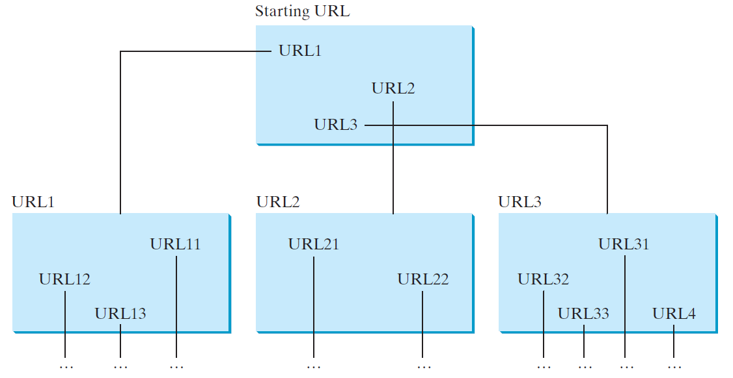
Web Crawler
You can create a webcrawler.
WebCrawler
Run

Slide 55

Homework - 1
Create a record of address with number, name of apartment, city.
Store 5 address information with ArrayList. Write this information in the file. Read the information from the file, write it on the console.

Slide 56
Next Lecture
The next lesson, we will continue.

Slide 57
Programming Session
ArrayList
Files
we will carry out applications.
nextLine()

Slide 58
Summary
As a result, this week we finished exception management. We wrote the information we kept in memory to the file to make it permanent, we read it. We'll continue next week. Come prepared. Study from textbook.

